Slide 1

Statistical Analysis on Indian Literacy
Mrinal Chandra Sarkar
Department of Statistics, Visva Bharati
B.Sc(Sem-VI)Stat-05
VB-3911 of 2020-21

Slide 2
Content
INTRODUCTION
OBJECTIVES
DATA DESCRIPTION
GRAPHICAL REPRESENTATION
DATA ANALYSIS
CONCLUSION
REFERENCE

Slide 3

INTRODUCTION
The ability to read and write is critical for personal development, social mobility, and economic growth.
India is a diverse country with a rich literary heritage and a complex social structure, which poses significant challenges to improving literacy rates. There are disparities in literacy rates across different social groups, regions, and genders.

Slide 4
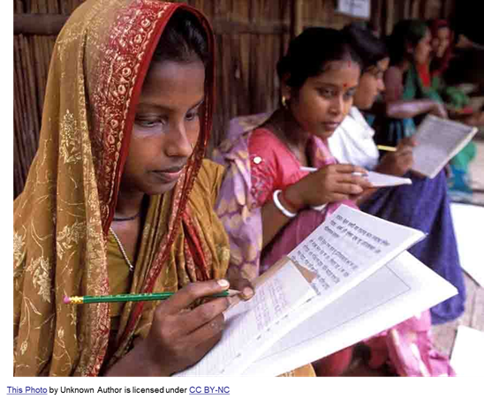

Introduction
Literacy : The ability to read and write is called literacy; its opposite is illiteracy. There are several degrees of literacy and many ways to define the benchmarks of who is literate and who is not. In census data any person of age 7 or above is considered as literate who are able to read and write in any language.
Literacy rate : It is ratio multiplied by 100 of no of literate people and total population of same group.

Slide 5
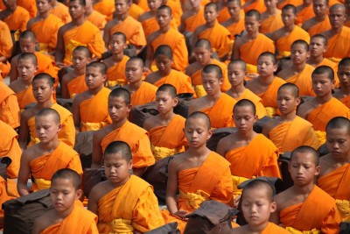
Introduction
Gender disparities : Difference in male and female literacy rate in a certain group. Here we considered for each states.
Social Disparities: Here we considered literacy rate among different social group as a measure of social disparities.
This Photo by Unknown Author is licensed under CC BY

Slide 6
OBJECTIVES
Here our objective is
Compare literacy in different states with National average data .
Determine if there are significant differences in literacy rates among Male & Female.
Determine if there are significant differences in literacy rates among two way classified different religions and location (rural, urban).

Slide 7
DATA DESCRIPTION
I have taken data from website kaggle and Indistat . It is Indian census 2011 dataset. The dataset Include column like male female Male literate Female literate Age group literacy for different states and union territory. And indiastat for location and religion wise data.
Data Source
https://www.kaggle.com/datasets/danofer/india-census?select=india-districts-census-2011.csv
https://www.indiastat.com/table/education/state-wise-literacy-rate-religious-communities-res/953566
https://github.com/tvganesh/india-literacy

Slide 8
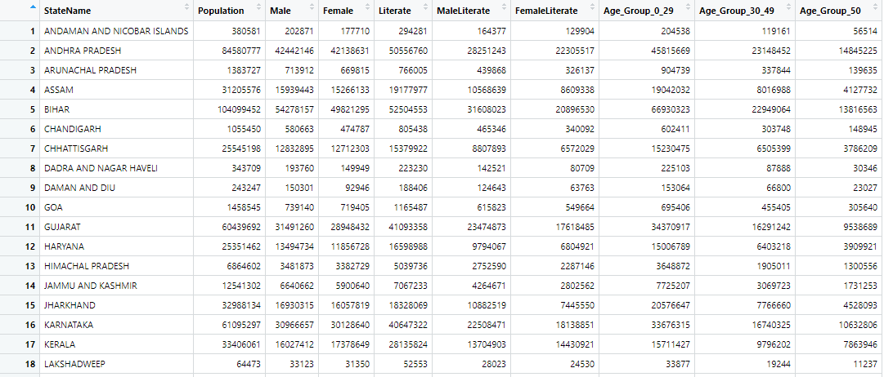
Datasets

Slide 9
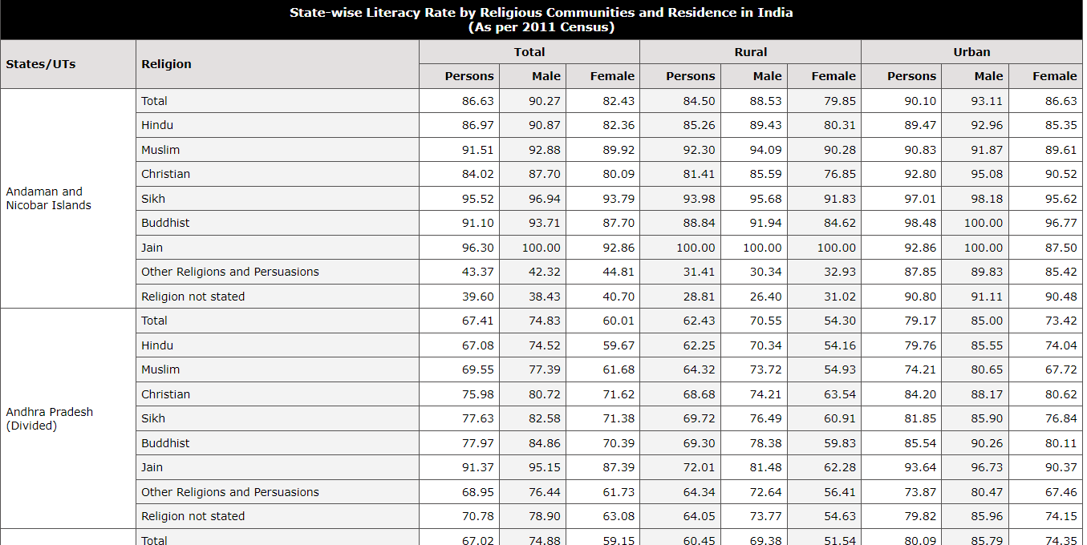
Datasets

Slide 10
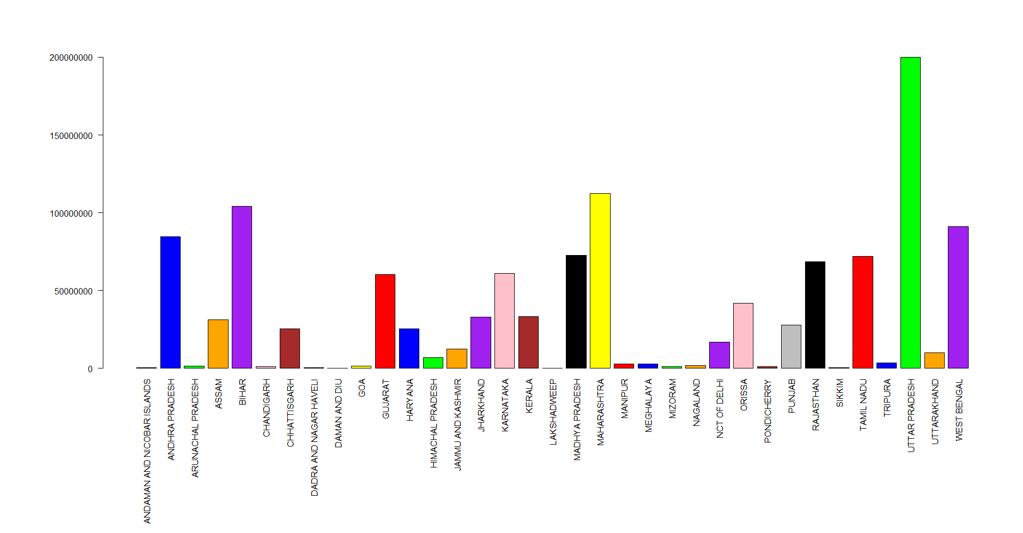
Population of States

Slide 11
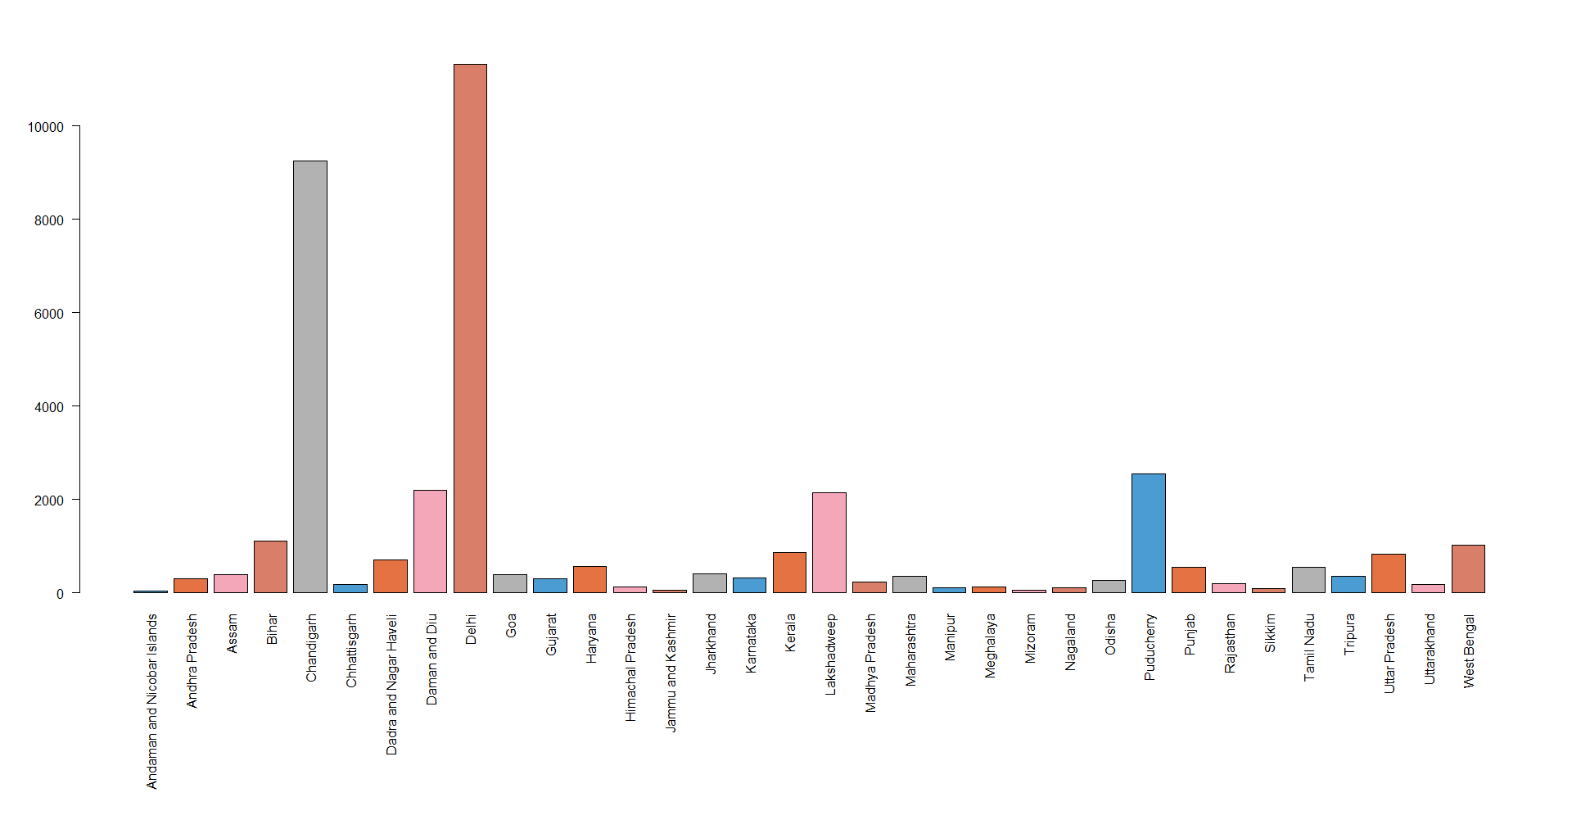
Population density
Notes:
10k / sq km

Slide 12
Correlation between Literacy rate and Population density
Correlation comes out to be 0.2950202
This indicate very weak correlation means with higher literacy rate states may or may not have higher population density.

Slide 13
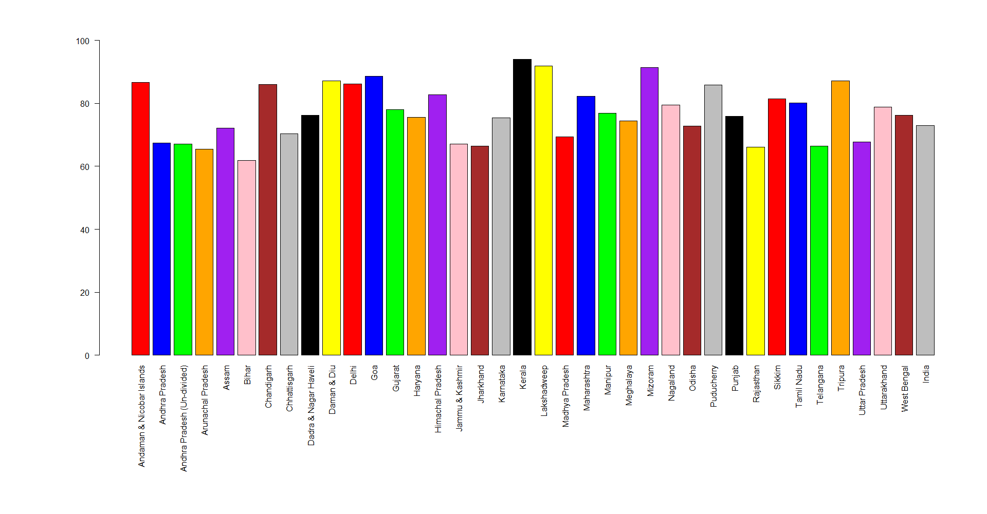
Literacy Rate

Slide 14
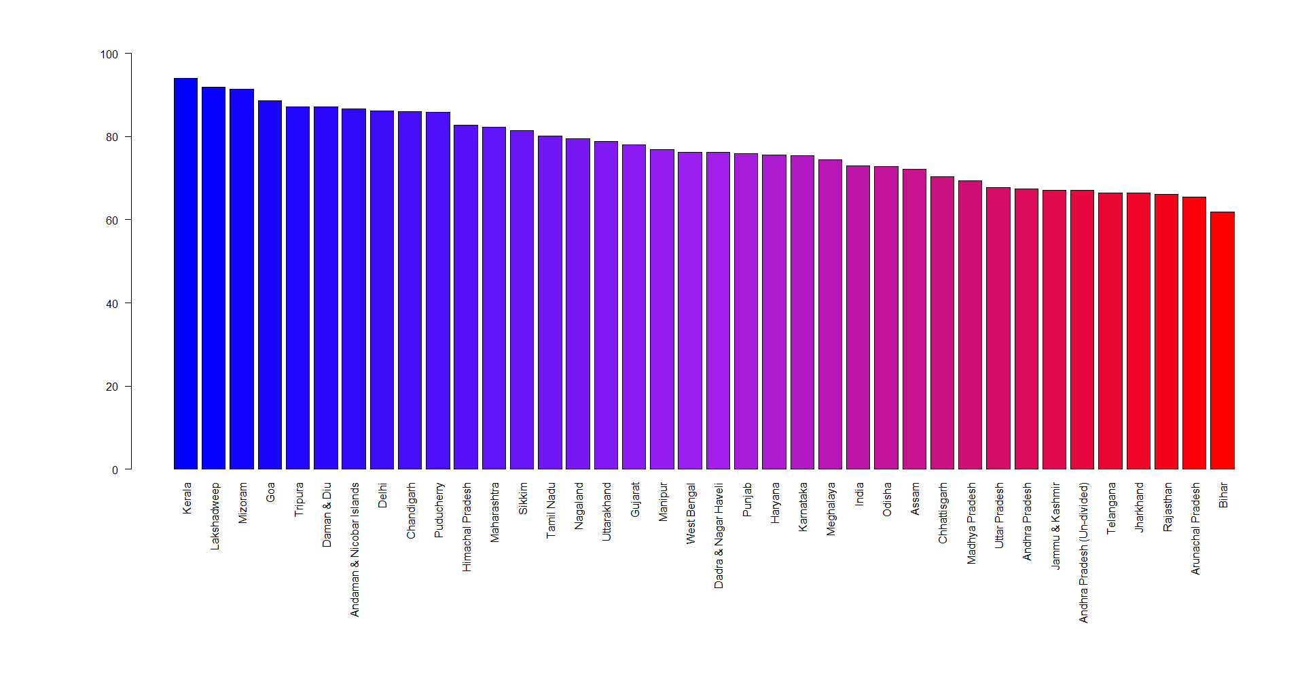
Literacy rate in order

Slide 15
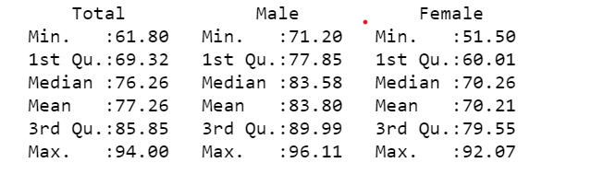
Summary :Literacy Rate
Average literacy rate in india is 74%
Minimum total literacy rate: 61.8% in Bihar
Maximum total literacy rate: 94% in Kerala

Slide 16
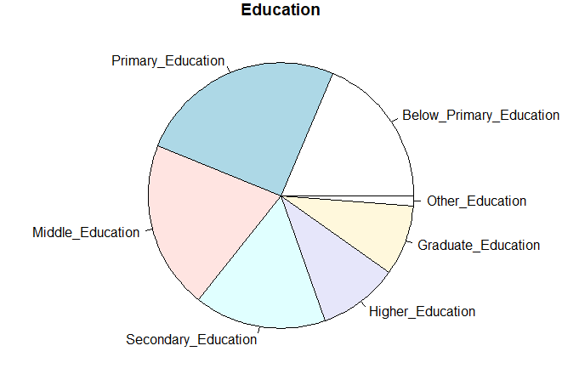
Education level
We can see there are huge portion of the population in below primary education.
More than 30% of the population is primarily educated and about 25% have basic education
Notes:
In percentage

Slide 17
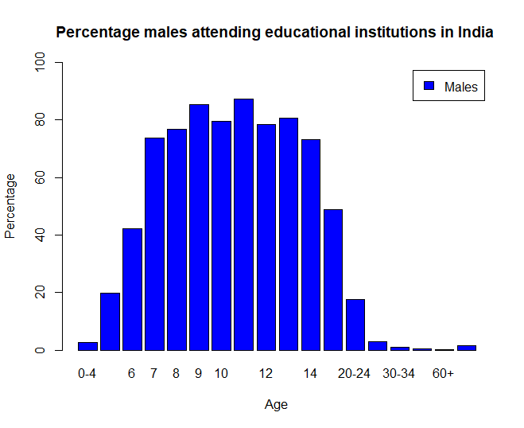
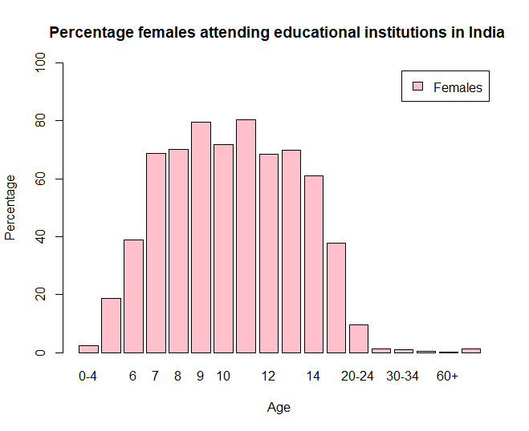
Literacy rate in different age Group all over India : Male & Females

Slide 18
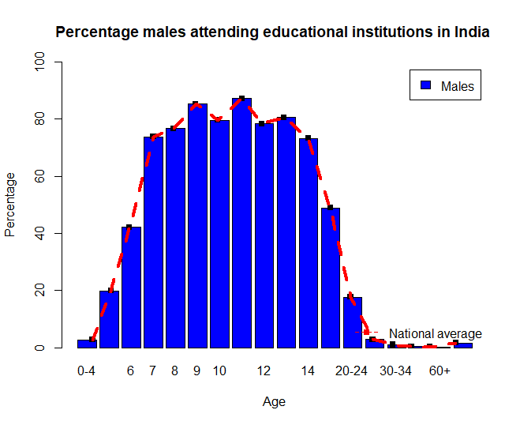

National literacy rate average line : Male & Females

Slide 19
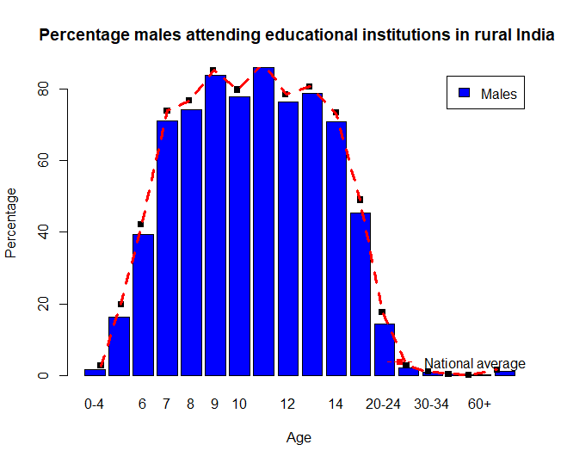
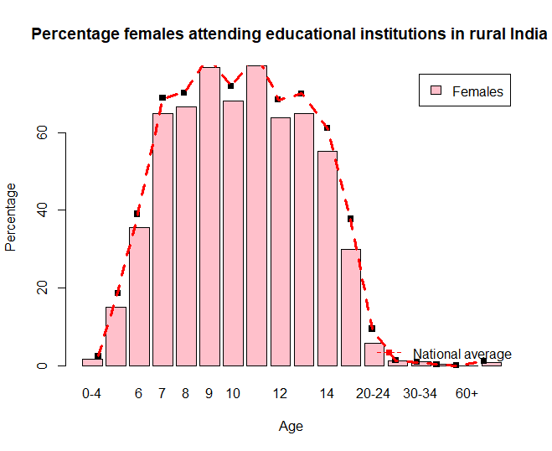
Literacy rate in Rural area

Slide 20
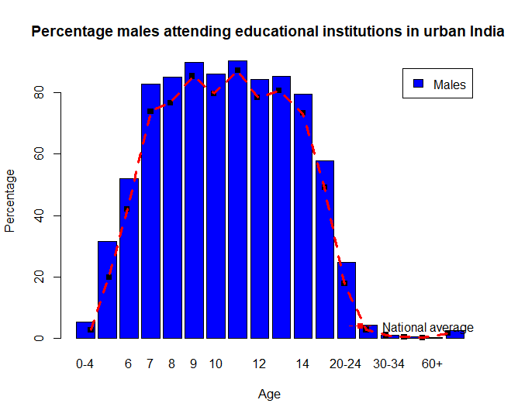
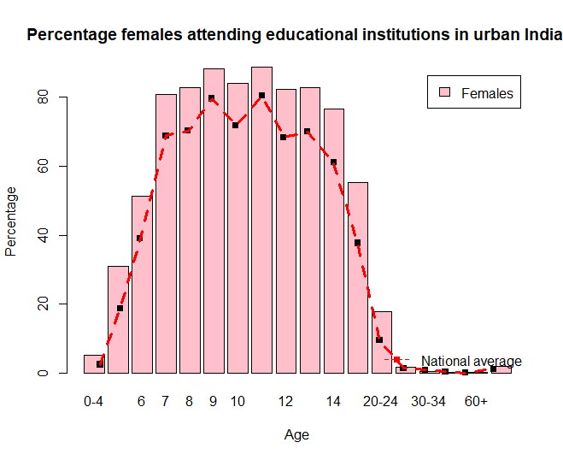
Literacy rate in Urban area

Slide 21
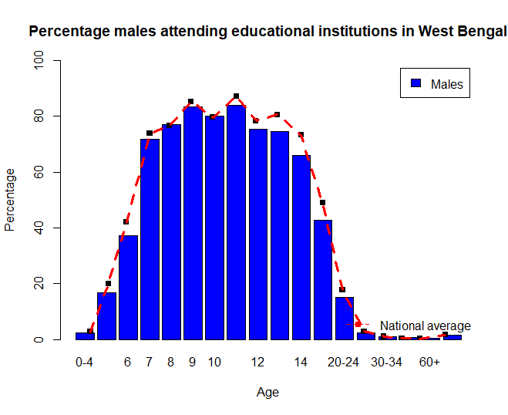
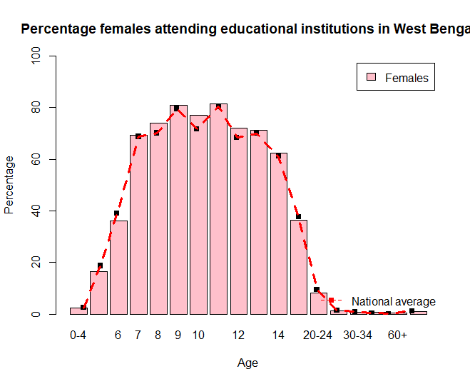
West Bengal Literacy rate with National average

Slide 22
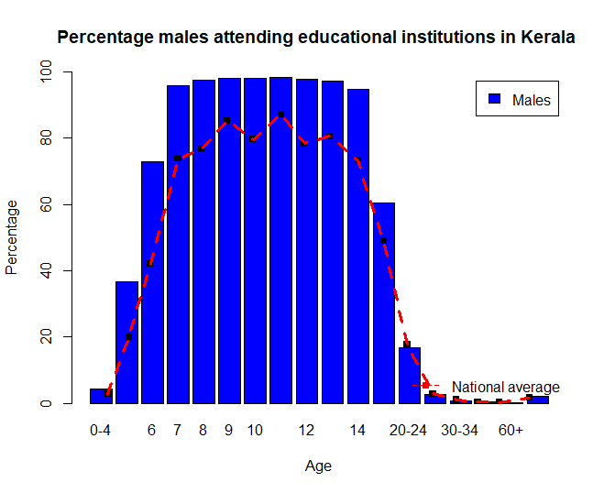
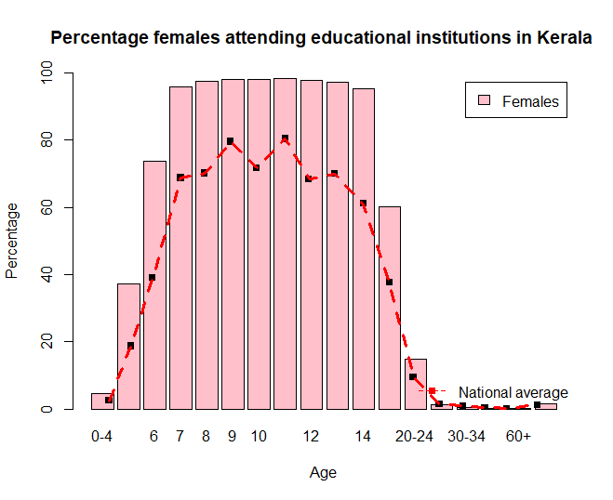
Kerala

Slide 23
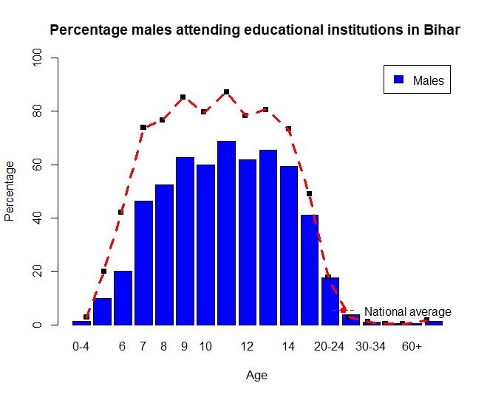
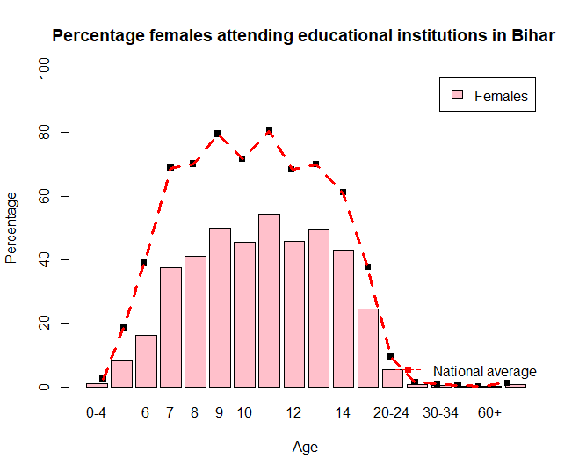
Bihar

Slide 24
Interpretation
Kerala is clearly the top ranker with the literacy rates for both males and females well above the average
The states with above average literacy are – Kerala, Himachal Pradesh, Uttarakhand, Tamil Nadu, Haryana, Himachal Pradesh, Karnataka, Maharashtra, Punjab, Uttarakhand
The states with just about average literacy – Karnataka, Andhra Pradesh, Chattisgarh, Gujarat, Madhya Pradesh, Odisha, West Bengal
The states with below average literacy – Uttar Pradesh, Bihar, Jharkhand, Arunachal Pradesh, Assam, Jammu and Kashmir, Jharkhand, Rajasthan

Slide 25
The Shapiro – Wilk’s Test
H0: The data comes from normal distribution.
Against
H1: The data does not coming from normal distribution.
Variable | p-value | Decision
Male literacy rate | 0.3104 | The data follows normal distribution
Female literacy rate | 0.3773 | The data follows normal distribution

Slide 26
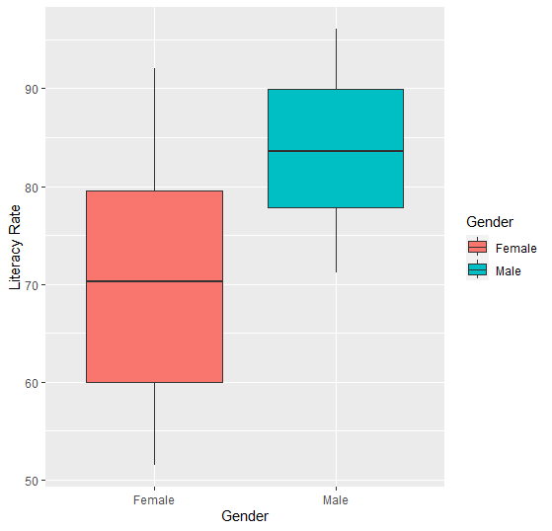
Boxplot: Male & Female
Literacy Rate
We perform one way ANOVA to test either male and female literacy rate are significantly different or not

Slide 27

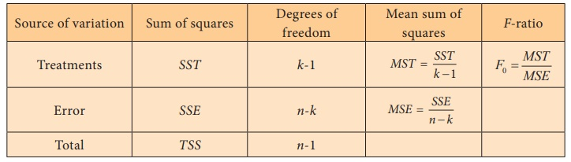
ANOVA (one way classified data)
Our hypothesis
H0: There is no significance difference in literacy rate between male and females
H1: There is significant difference
Notes:
The mathematical model that describes the relationship between the response and treatment for the one-way ANOVA is given by

Slide 28
ANOVA Table
Factors | Degrees of freedom | Sum of Squares | Mean Squares | Fcal | Ftab
Between classes | 1 | 3415.2 | 3415.2 | 40.536 | 3.99
Error | 72 | 6066.1 | 84
Fcal > Ftab So we reject the null hypothesis.
There is a significant difference in literacy rate between males and females, and that this difference is not due to chance.
Notes:
P value F value Interaction effects \\ Reject null

Slide 29
Remark
The significant difference in literacy rates between males and females, this is an indication of gender-based discrimination or bias in access to education and opportunities. It may also reflect wider societal attitudes towards gender roles and the value placed on education for different genders.
This suggests that the difference is unlikely to be due to chance and we should address importance in promoting gender equality and ensuring that all individuals have equal access to education and opportunities to success.

Slide 30
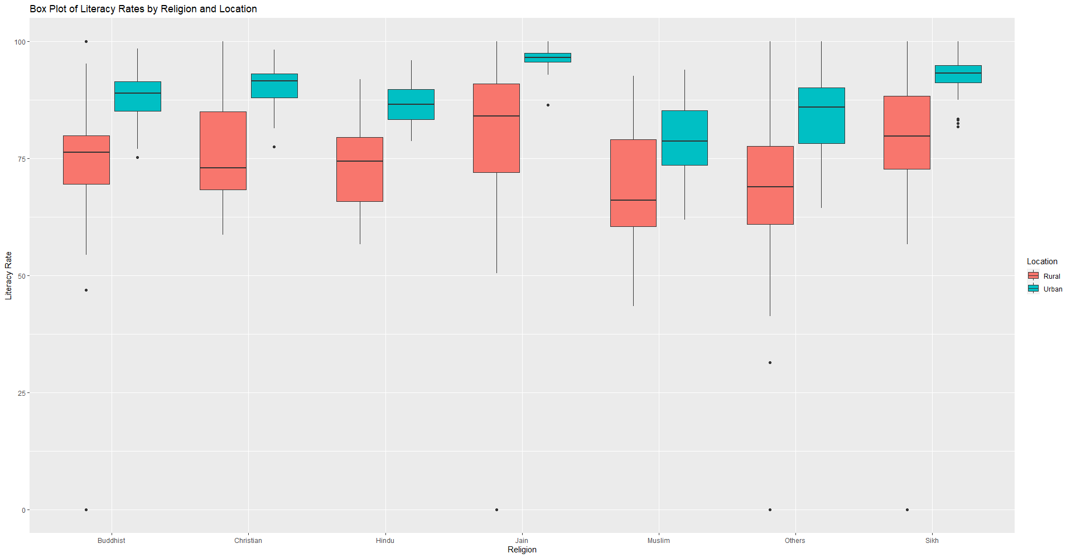
Boxplot: Literacy rate in different religion and rural urban population

Slide 31
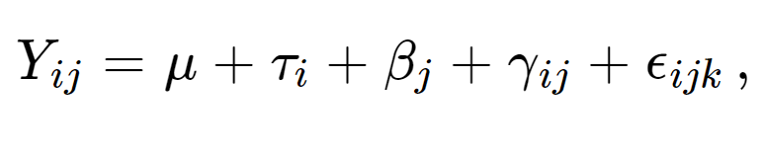
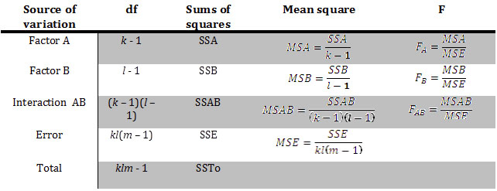
Two way ANOVA (m observation per cell)

Slide 32
Two way ANOVA
Test hypothesis
H01: There is significant difference in literacy rate in different religions.
H11 :There is no significant difference in literacy rate in different religions.
H02 :There is significant difference in literacy rate in urban and rural population
H12: There is no significant difference in literacy rate in urban and rural population

Slide 33
ANOVA Table
Factors | Degrees of freedom | Sum of Squares | Mean Squares | Fcal | Ftab
Religion | 6 | 11346 | 1891 | 14.4 | 2.01
Location | 1 | 24607 | 24607 | 187.3 | 3.84
Interaction | 6 | 613 | 102 | 0.7 | 2.01
Error | 504 | 66184 | 131
For religions Fcal > Ftab indicating a significant effect of religion on the literacy rate.
For location Fcal > Ftab indicating a significant effect of location on literacy rate.
And Interaction effect Fcal < Ftab indicating that there is no significant interaction effect in literacy between religion and location.
Notes:
P value F value Interaction effects \\ Reject null

Slide 34
Conclusion
Increase access to education: Governments and non-governmental organizations should prioritize education as a fundamental right and increase access to schooling.
Promote gender equality: Education for girls and women is often neglected in many countries.
Improve the quality of education: To improve literacy rates in India, there is a need to improve the quality of education. This can be achieved by investing in teacher training programs, providing access to up-to-date educational materials and technology.
Involve communities in education: Engaging communities in education can help to ensure that education is relevant and meets the needs of local communities.

Slide 35
Reference
https://gigadom.wordpress.com/2015/01/05/a-peek-into-literacy-in-india-statistical-learning-with-r/
https://www.kaggle.com/datasets/danofer/india-census?select=india-districts-census-2011.csv
https://www.indiastat.com/table/education/state-wise-literacy-rate-religious-communities-res/953566

Slide 36
Thank You
Notes:
OKK

